Slide 1
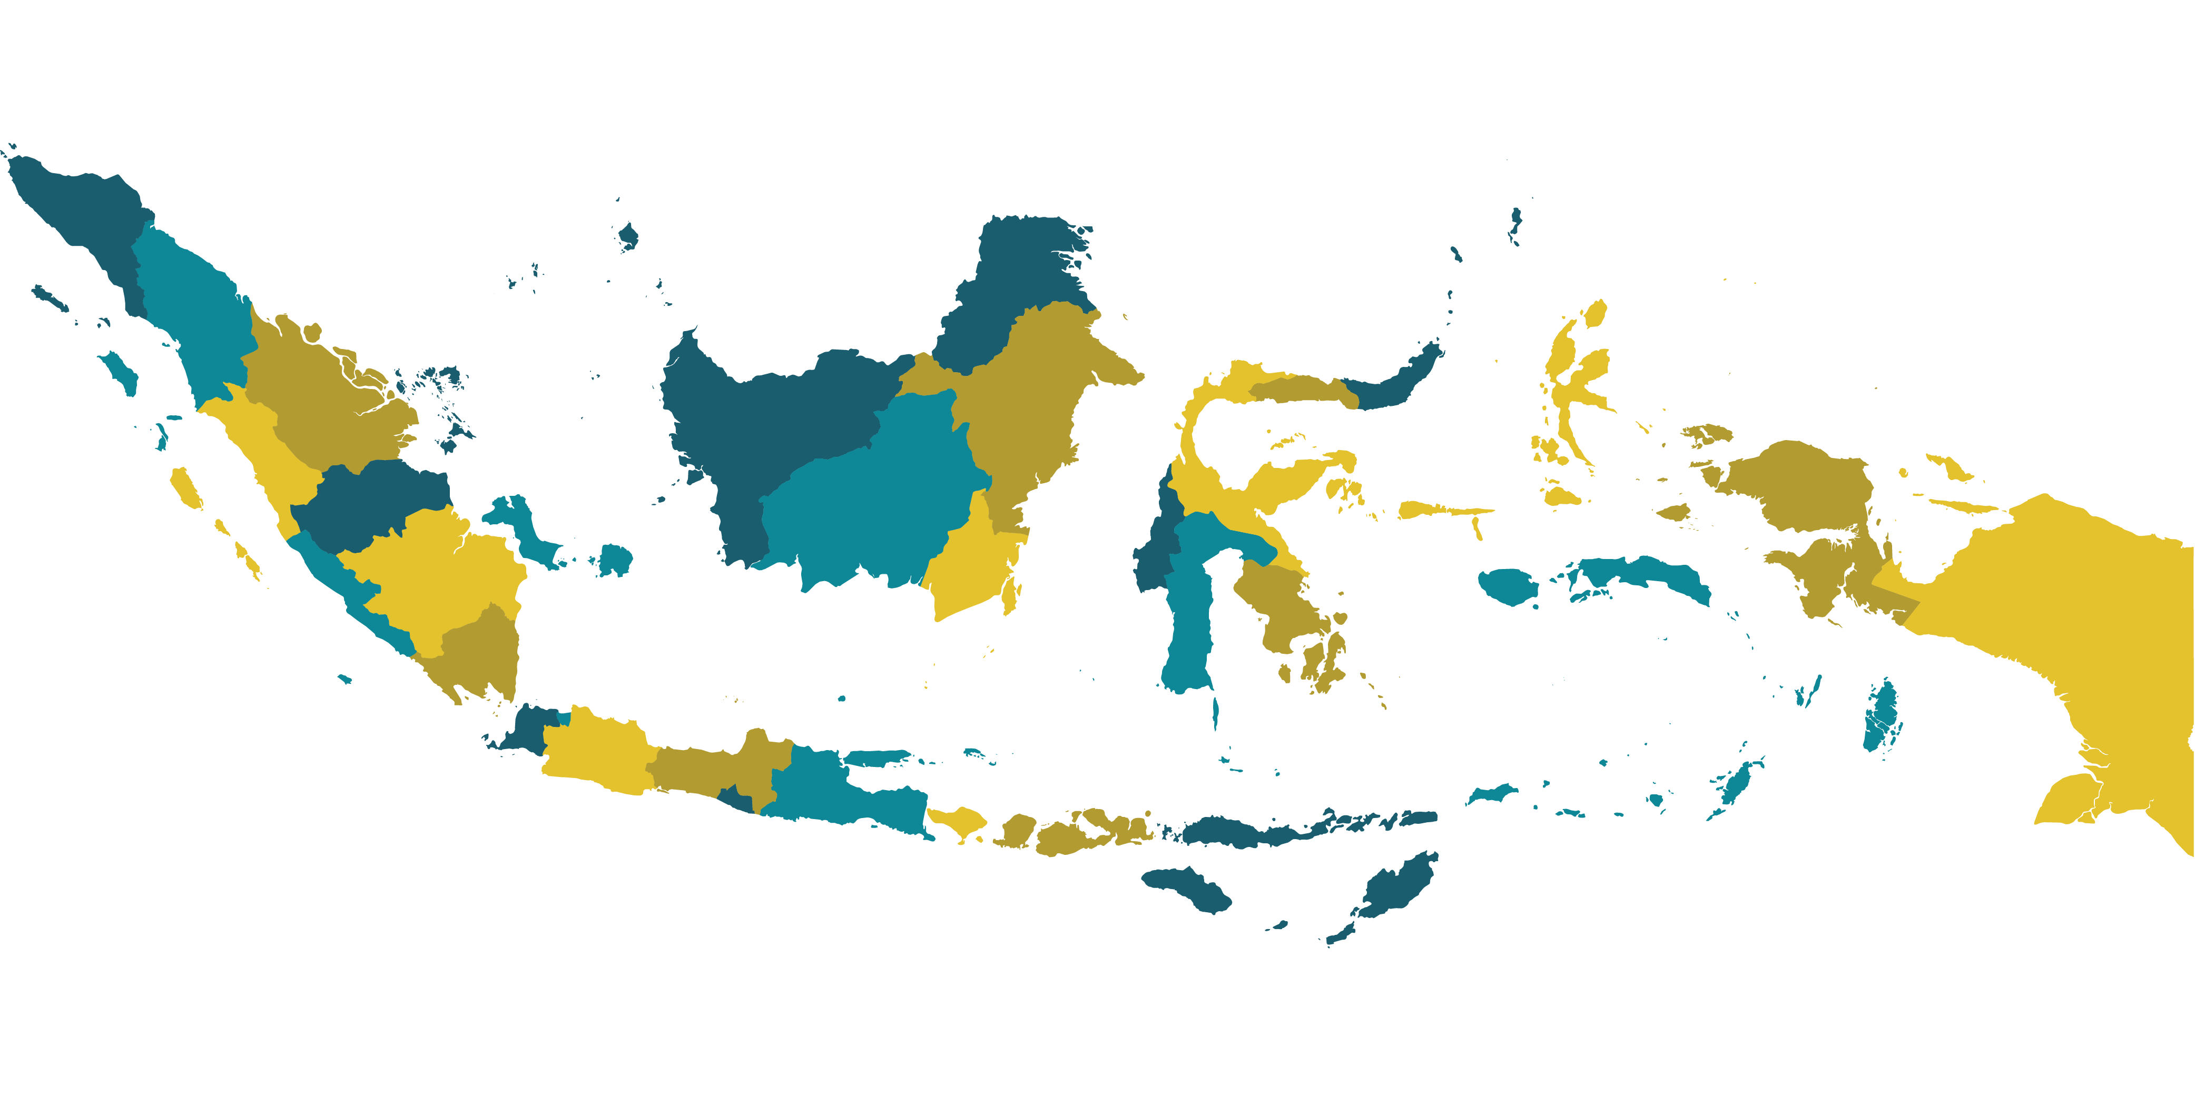
Innovations to Fast-Tracking the HIV Response in Indonesia
Session 2 – Monday, 23 July 2018, 10.55-12.15

Slide 2
LIST OF SPEAKERS
Digital Application for Optimizing Key Population Mobile Testing - Dr Aulia Human, LINKAGES
Empowering Young People to gain Access to Services through m-apps - Missael Hotman Napitupulu, Fokus Muda
Bringing HIV testing services closer through community-based screening - Tengku Surya Mihari, GWL-INA
Breaking barriers through new-outreach model for FSW - Liana Andriyani, OPSI
Partner-Family ART Supporter: Initiative that Paved The Way for Partner Notification Strategy - Dr. Linna Juniar, Jatinegara Health Clinic
Non Surgical Male Circumsition (PrePex) in Papua - Dr. Donald Willem Aronggear, SpB, FINACS, Deputy Director of Jayapura Regional Public Hospital

Slide 3
Digital Application for Optimizing Key Population Mobile Testing
Dr Aulia Human, LINKAGES, Indonesia

Slide 4
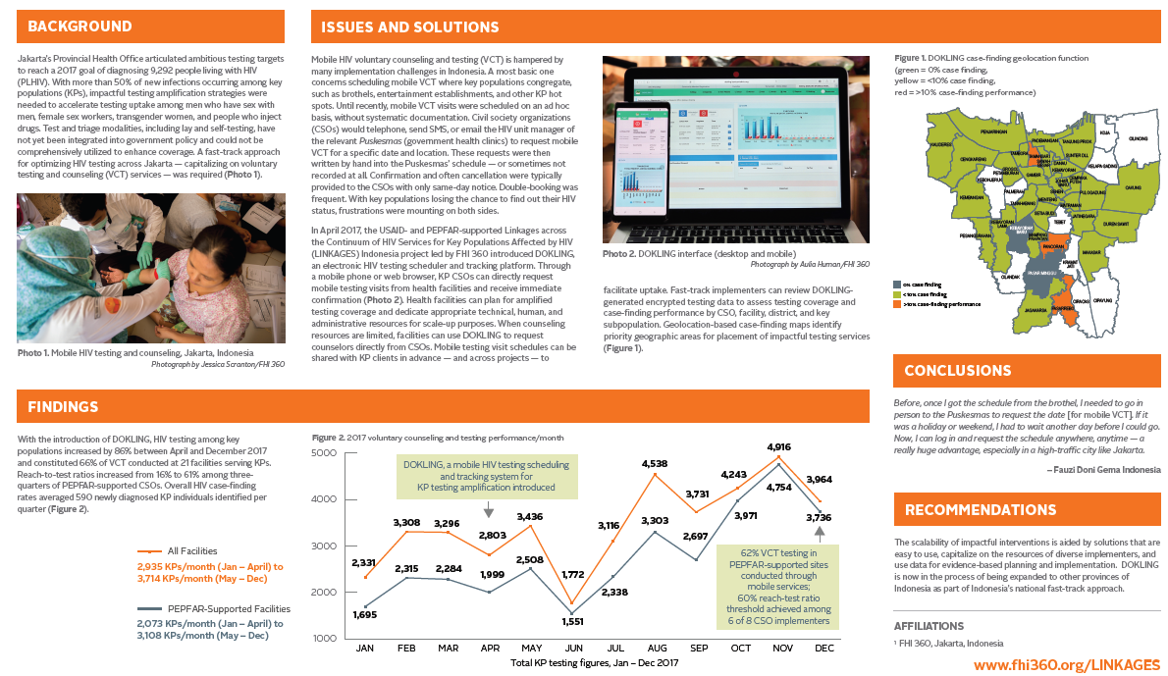

Slide 5
Empowering Young People to gain Access to Services through m-apps
Missael Hotman Napitupulu, Fokus Muda, Indonesia

Slide 6
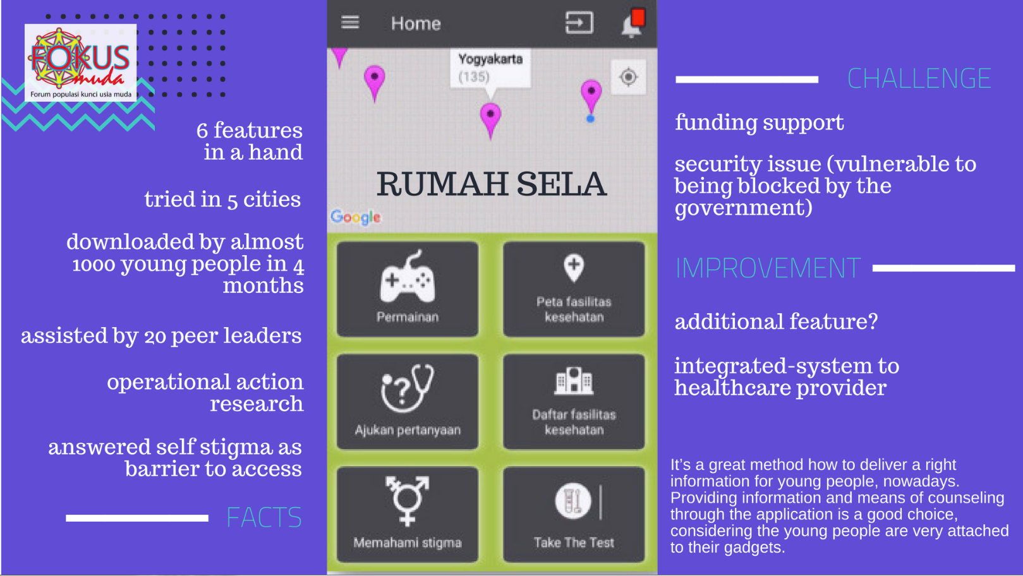

Slide 7
Bringing HIV testing services closer through community-based screening
Tengku Surya Mihari, GWL-INA, Indonesia

Slide 8
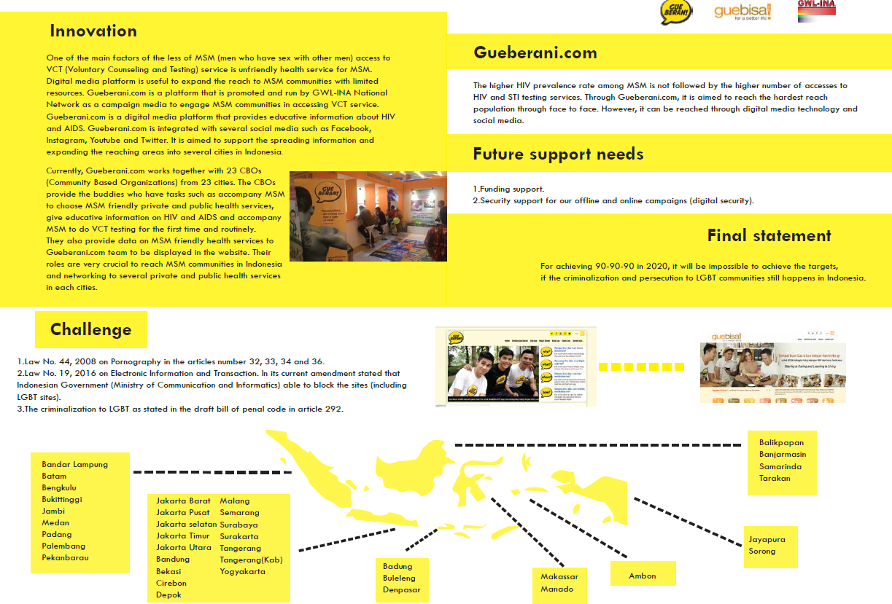

Slide 9
Breaking barriers through new-outreach model for FSW
Liana Andriyani, OPSI (Indonesia Sex Workers Network), Indonesia

Slide 10
A NEW APPROACH TO HIV PREVENTION
Community-led Mapping
Search and find
HIV testing
Case Management
Contexts: After brothels/
localizations closure >> new hotspots
Search for clusters of undiagnosed HIV
Accompany to test for HIV and be there for the result
Accompany to hospitals, provide counseling, starting treatment, solve problems

Slide 11
Partner-Family ART Supporter: Initiative that Paved The Way for Partner Notification Strategy
Dr. Linna Juniar, Primary Health Care Centre (Puskesmas) Jatinegara, Jakarta, Indonesia

Slide 12
Only 50% of those who initiated treatment are currently on treatment in DKI Jakarta Province, including in Puskesmas Jatinegara (March, 2018)
Notes:
Retention to treatment is an issue in Indonesia, including in DKI Jakarta Province. Only 50% of those who initiated treatment are currently on treatment (March, 2018).
Puskesmas Jatinegara, one of DKI Jakarta District Primary Health Care that provided HIV services since 2014, has a similar retention rate.
Strong family bonding is an Indonesian culture, and hence, intervention to involve family to serve as treatment supporter is considered suitable to improve retention.
Those who are diagnosed positives were encouraged to disclose and notify partners through self-referral or dual referral. Partners are provided with HIV information and encouraged to provide support. Those who do not have partners are encouraged to bring the family for counseling.
From November 2017 - June 2018, all PLHIV on treatment with no treatment supporter are ensured to have one either from NGO or family member; while newly registered PLHIV are encouraged to notify partners and disclose to family. In June 2018, among 121 PLHIV on treatment, 79 patients (65%) have notified their partners, 71 partners (90%) have been tested, and 35 partners are positives (49%). Of 121 PLHIV on ART, 86% of them has treatment supporter from family.
Treatment supporter might be contributing to PLHIV who are still on treatment in the Puskesmas.
High yield of HIV positive from partners urges “Intensive Partner Notification” to be implemented at healthcare facilities.

Slide 13
Among 121 PLHIV on treatment,
65% have notified their partners
90% of partners have been tested
49% of partners are positive
86% has treatment supporter
from family
(November 2017 - June 2018)
All PLHIV with no treatment supporter are ensured to have one either from NGO or family member; newly registered PLHIV are encouraged to notify partners
High yield of HIV positive from partners urges “Intensive Partner Notification” to be implemented at healthcare facilities
Strong family bonding as an Indonesian culture
Involving family as treatment supporter is suitable to improve retention
PLHIV notify family by self-referral/ dual-referral
Notes:
Retention to treatment is an issue in Indonesia, including in DKI Jakarta Province. Only 50% of those who initiated treatment are currently on treatment (March, 2018).
Puskesmas Jatinegara, one of DKI Jakarta District Primary Health Care that provided HIV services since 2014, has a similar retention rate.
Strong family bonding is an Indonesian culture, and hence, intervention to involve family to serve as treatment supporter is considered suitable to improve retention.
Those who are diagnosed positives were encouraged to disclose and notify partners through self-referral or dual referral. Partners are provided with HIV information and encouraged to provide support. Those who do not have partners are encouraged to bring the family for counseling.
From November 2017 - June 2018, all PLHIV on treatment with no treatment supporter are ensured to have one either from NGO or family member; while newly registered PLHIV are encouraged to notify partners and disclose to family. In June 2018, among 121 PLHIV on treatment, 79 patients (65%) have notified their partners, 71 partners (90%) have been tested, and 35 partners are positives (49%). Of 121 PLHIV on ART, 86% of them has treatment supporter from family.
Treatment supporter might be contributing to PLHIV who are still on treatment in the Puskesmas.
High yield of HIV positive from partners urges “Intensive Partner Notification” to be implemented at healthcare facilities.

Slide 14
Non Surgical Male Circumsition (PrePex) in Papua
Dr. Donald Willem Aronggear, SpB, FINACS, Deputy Director of Jayapura Regional Public Hospital

Slide 15
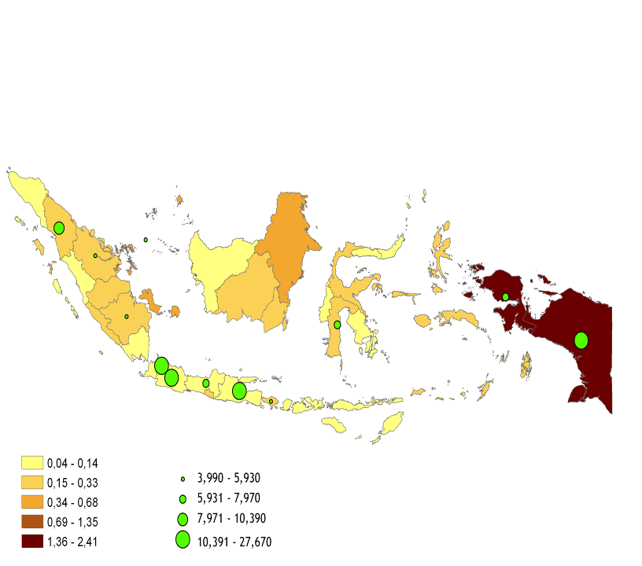
VOLUNTARY MALE MEDICAL CIRCUMCISION
PARTICIPANTS IN 2015 – 2018 Source: RSUD Jayapura
PARTICIPANTS IN 2015 – 2018
1.251 PARTICIPANTS
Culture:
Avoid religious debate
Objective:
Circumcision for hygiene and health can prevent transmission of HIV, HPV, and sexually transmitted infections
Provide benefits directly
Estimated HIV prevalance in population :
Estimated number
of PLHIV
Cases of HIV AIDS in Papua has been included in general population of society (Low Generalized Epidemic) with prevalence 2,3% (STBP 2013).
RECOMENDATIONS:
“ABC”
Voluntary Male Circumcision is an additional strategy to HIV AIDS prevention.
Abstinence
Be Faithful
Condom, Counseling, Circumcision
SOLUTIONS
- Circumcision protect from HIV & STI (WHO)
- Circumcision can reduce the risk of HIV up to 76 % (AVAC
METHODS
- Non Surgical Circumcision with PrePex,
- No Injection, No Surgery, No Blood
- More Simple, More Clean
PROGRAM TIMELINE - 2008: Promotion
- 2014: Eligibility and Acceptance Study
- 2015: Circumcision in Jayapura City
- 2018: Expansion to Merauke and Nabire

Slide 16
Q & A SESSION

Slide 17
THANK YOU! TERIMA KASIH!

